Slide 1

2013 4th International Conference on Agriculture and Animal Science
CAAS 2013
Climate Change Impacts on Agricultural Products in Thailand:
A Case Study of Thai Rice at the Chao Phraya River Basin
November 24, 2013
Presenter: Phongphanich Nara (Mr.)
Advisers: Guan-Guay Mao and Tsair-Bor Yen
Graduate Institute of Landscape Architecture and Recreation Management (LARM)
Department of Tropical Agriculture and International Cooperation (DTAIC)
National Pingtung University of Science and Technology (NPUST), Taiwan

Slide 2
Outline
II
Literature Review
Introduction
I
IV
Finding
V
Conclusion
Page 2

Slide 3
Introduction

Slide 4
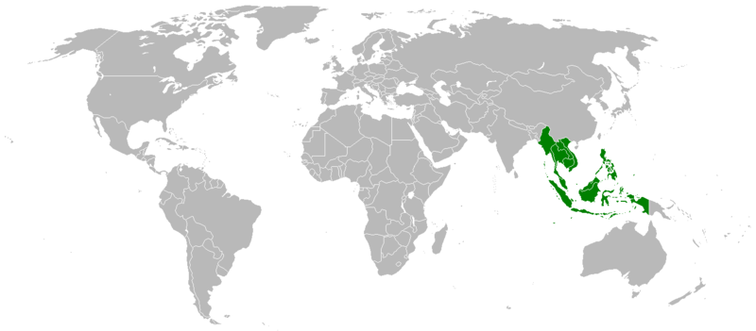
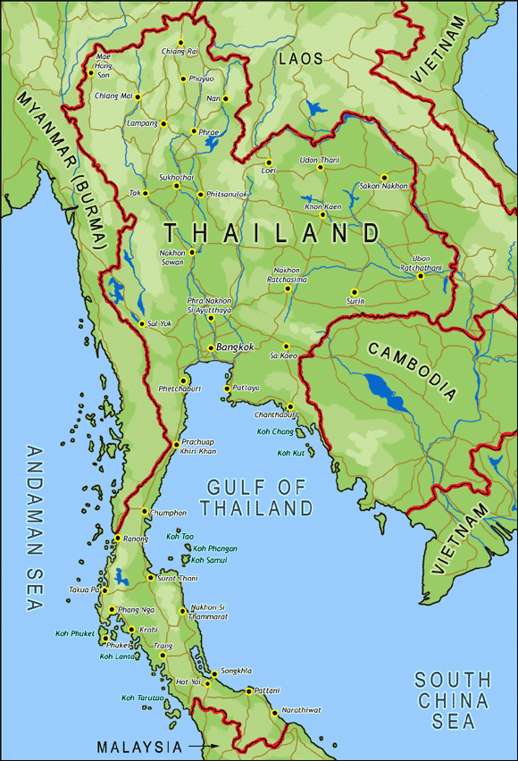
Background
The most of climate change impact on agriculture would appear to be the tropical region of the world (Priyanka, 2009).
Thailand is located in the Southeast Asia Region, within the tropical belt will be most influenced (Minas & Frank, 2001).
N
Figure 1. Map of Southeast Asia Region
Source: http://www.nationsonline.org/oneworld/map_of_southeast_asia.htm
Page 4

Slide 5
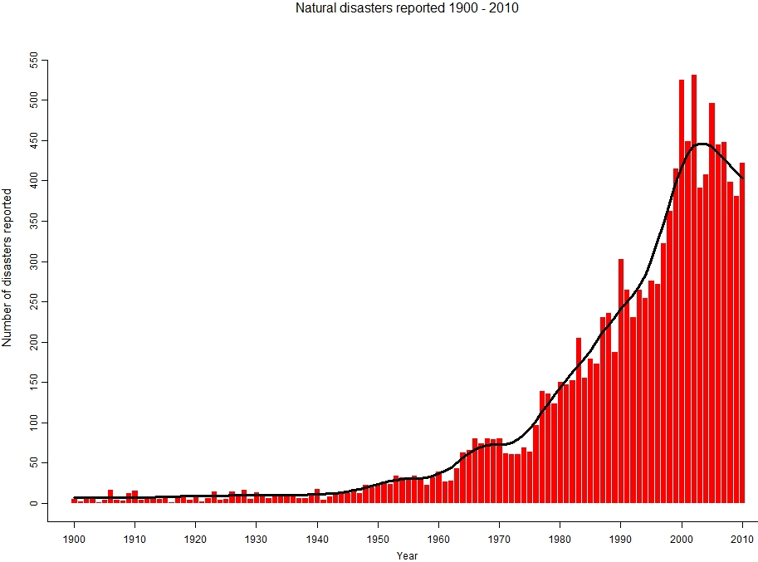
Background
Global warming mainly causes climate change which influences direct agriculture as increasing the temperature, changing the rainfall rate, water-preservation and soil fertility (Priyanka, 2009).
Figure 2. Natural Disasters Reported 1900-2010
Source: EM-DAT: The OFDA/CRED International Disaster Database
Page 5

Slide 6
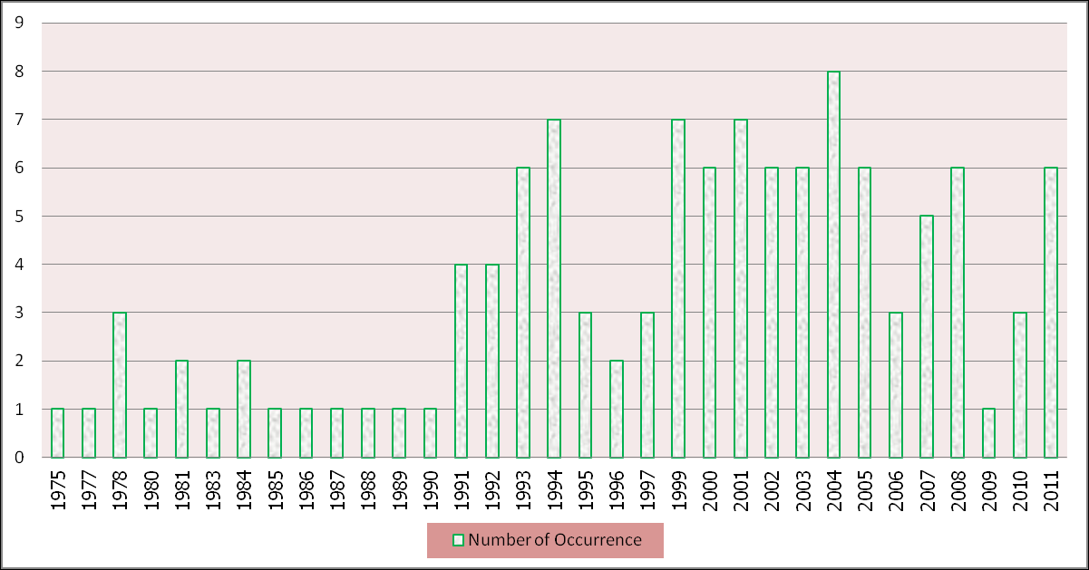
Background
According to the International Disaster Database (EM-DAT), the number of disaster events reported in Thailand during 1970-2011 increased, from 5 (during 1970-1979) to 63 (during 2000-2011).
Figure 3. Occurrence of Natural Disaster in Thailand during 1970-2011
Source: EM-DAT: The OFDA/CRED International Disaster Database (Thampanishvong , 2012)
Page 6

Slide 7
Literature Review

Slide 8
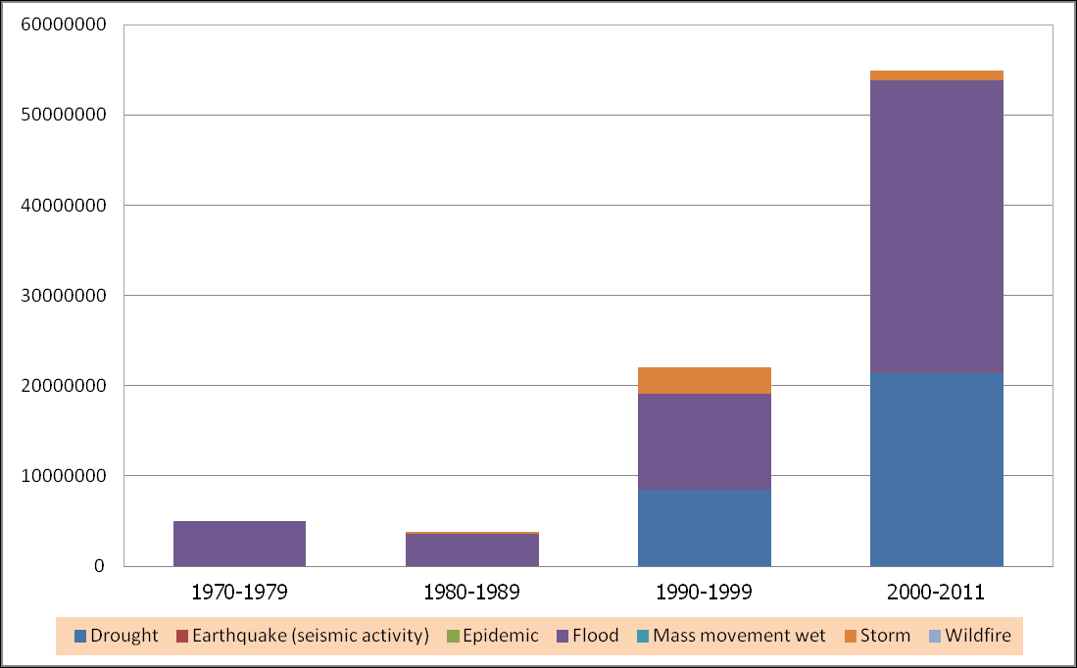
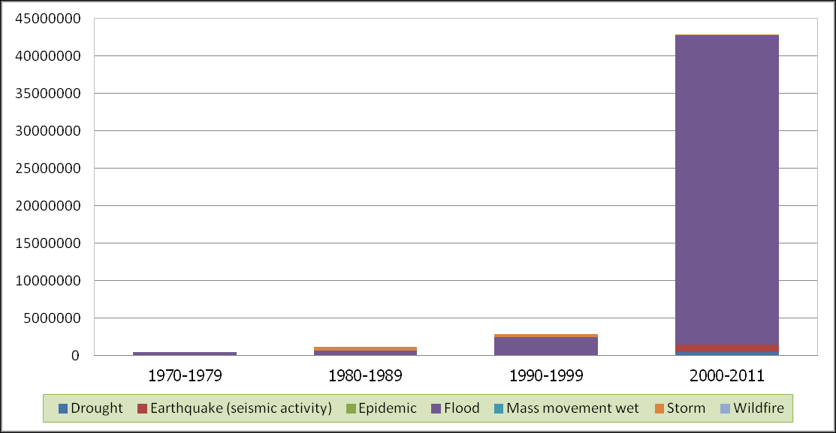
Thailand Flood
Since the 2000s until 2011s, flood has been the natural disaster that has imposed tremendous impacts on Thailand, both in terms of total number of people affected and economic losses.
The potential impacts of climate change to Thailand; such as floods, droughts and severe storms, is more likely to put the Thailand agricultural products at risk.
(a)
(b)
Figure 4. (a) Total Number of People Affected by Natural Disaster in Thailand during 1970-2011, (b) Total Economic Losses (Damages) from Natural Disaster: Thailand (thousands US$)
Source: EM-DAT: The OFDA/CRED International Disaster Database (Thampanishvong , 2012)
Page 8

Slide 9
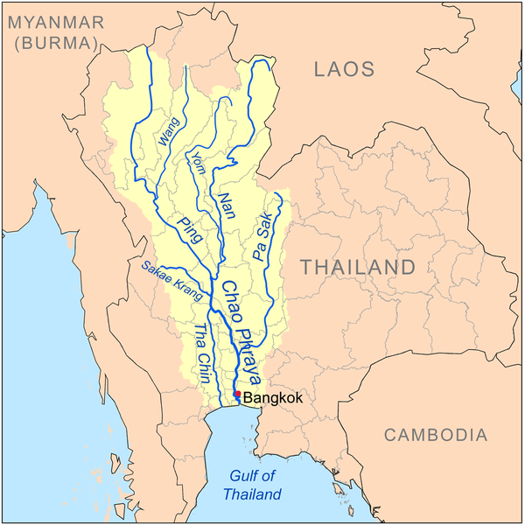
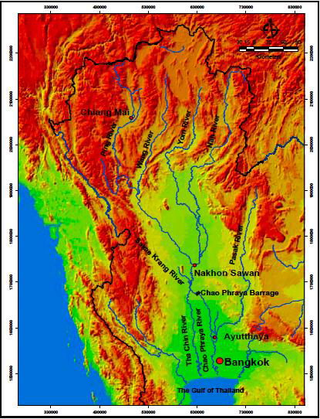
Chao Phraya River Basins (study area)
The Chao Phraya River Basins (CPRB) was the largest river basin in Thailand, the most fertile region of the country with a catchment area of 162,800 square kilometer.
The CPRB can be divided into eight sub-basins including:
  The Ping, Wang, Yom, Nan Rivers (known as the upper CPRB); and
  The Chao Phraya, Sa-Kae Krang, Pasak, and Tha- Chin Rivers (known as the lower CPRB).
(Aon Corporation, 2012)
Figure 5. Map of the Chao Phraya River Basins
Source: http://en.wikipedia.org/wiki/File:Chaophrayarivermap.png and World Bank (2009)
Page 9

Slide 10
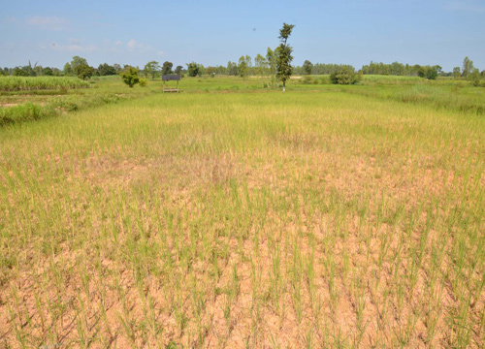
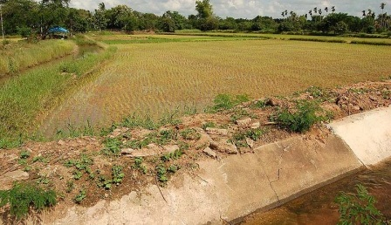
Thai Rice
Thai rice cycle and rice growing seasons starts in May and ends in September, it can be also divided into two main types by the rice cultivation:
  In-season rice or known as the “Major rice” (May to October), and
  Off-season rice or known as the “Second rice” (November to April).
Off-season rice: good irrigation
In-season rice: no irrigation
Figure 6. Types of Thai Rice by the cultivation
Source: http://www.chaipat.or.th/chaipat/index.php?option=com_content&task=view&id=40&Itemid=71
Page 10

Slide 11
Finding

Slide 12
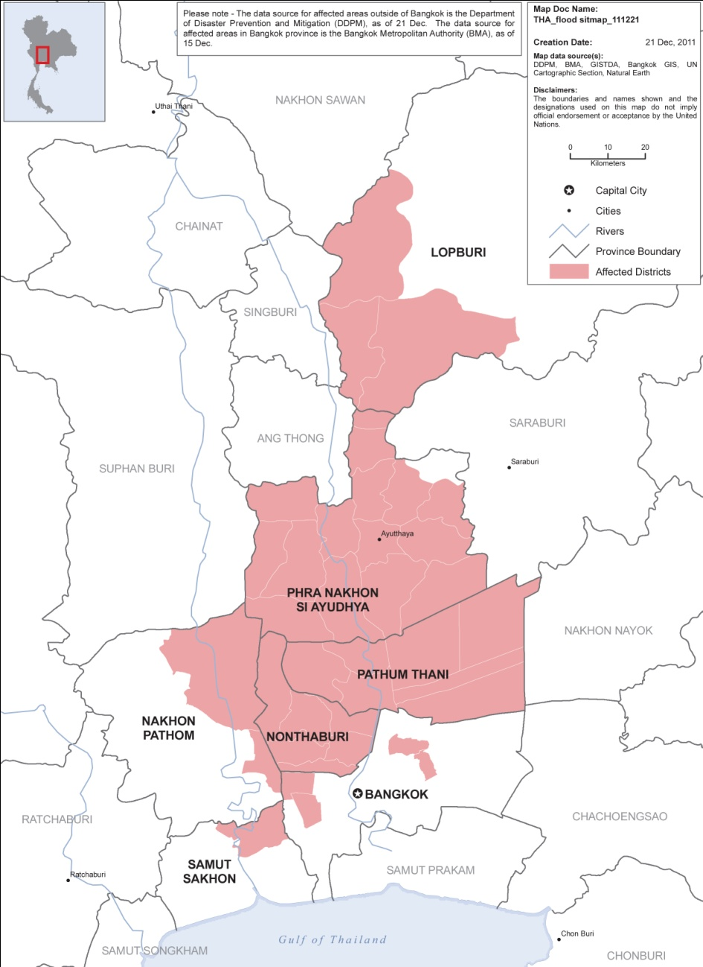
Effects of Flooding in Thailand
The World Bank reported that the 2011 flood has caused an estimate 45.7 US billion in economic damages and losses (World Bank, 2012).
The 2011 flood was also claimed that this disaster has ranked as the world’s fourth costliest disaster as of 2011 (World Bank, 2012).
Figure 7. Thailand: Floods as of 21 December 2011
Source: Office for the Coordination of Humanitarian Affairs (OCHA)
Page 12

Slide 13
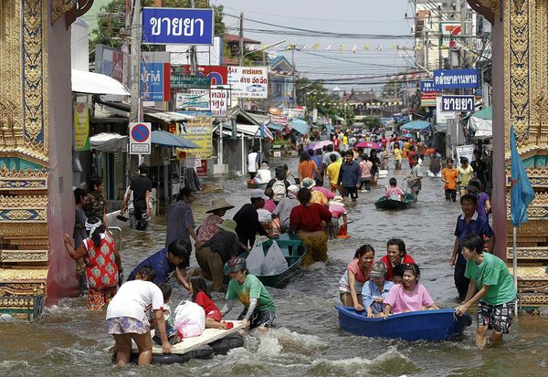
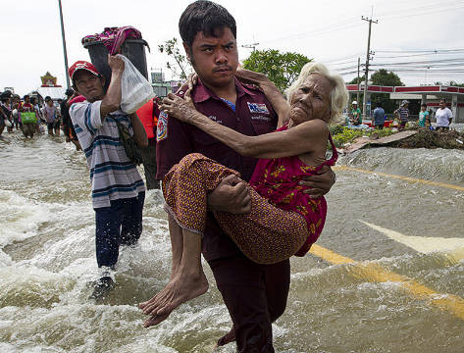
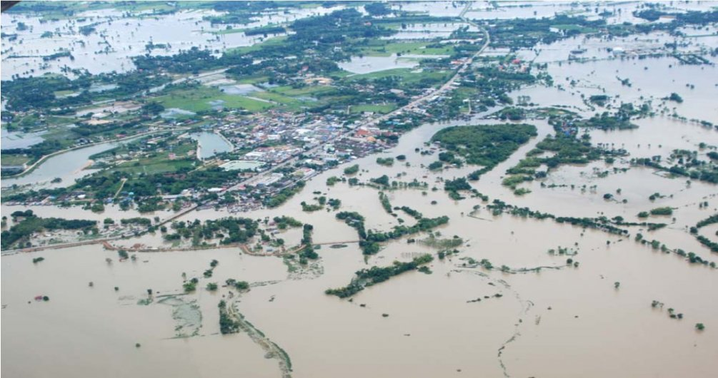
Effects of Flooding in Thailand
The flood waters have hit 65 of Thailand’s 77 provinces (84%).
More than 815 people were killed and affected 13,595,192 million people, and damaged agricultural areas 1,836,065.6 million hectares.
The World Bank has estimated 45.7 billion USD in economic damages and losses due to flooding
(Aon Corporation, 2012; World Bank, 2012)
Figure 8. Thailand: Floods as of 21 December 2011
Source:U.S. Marines , 2011; Aon Corporation, 2012
Page 13

Slide 14
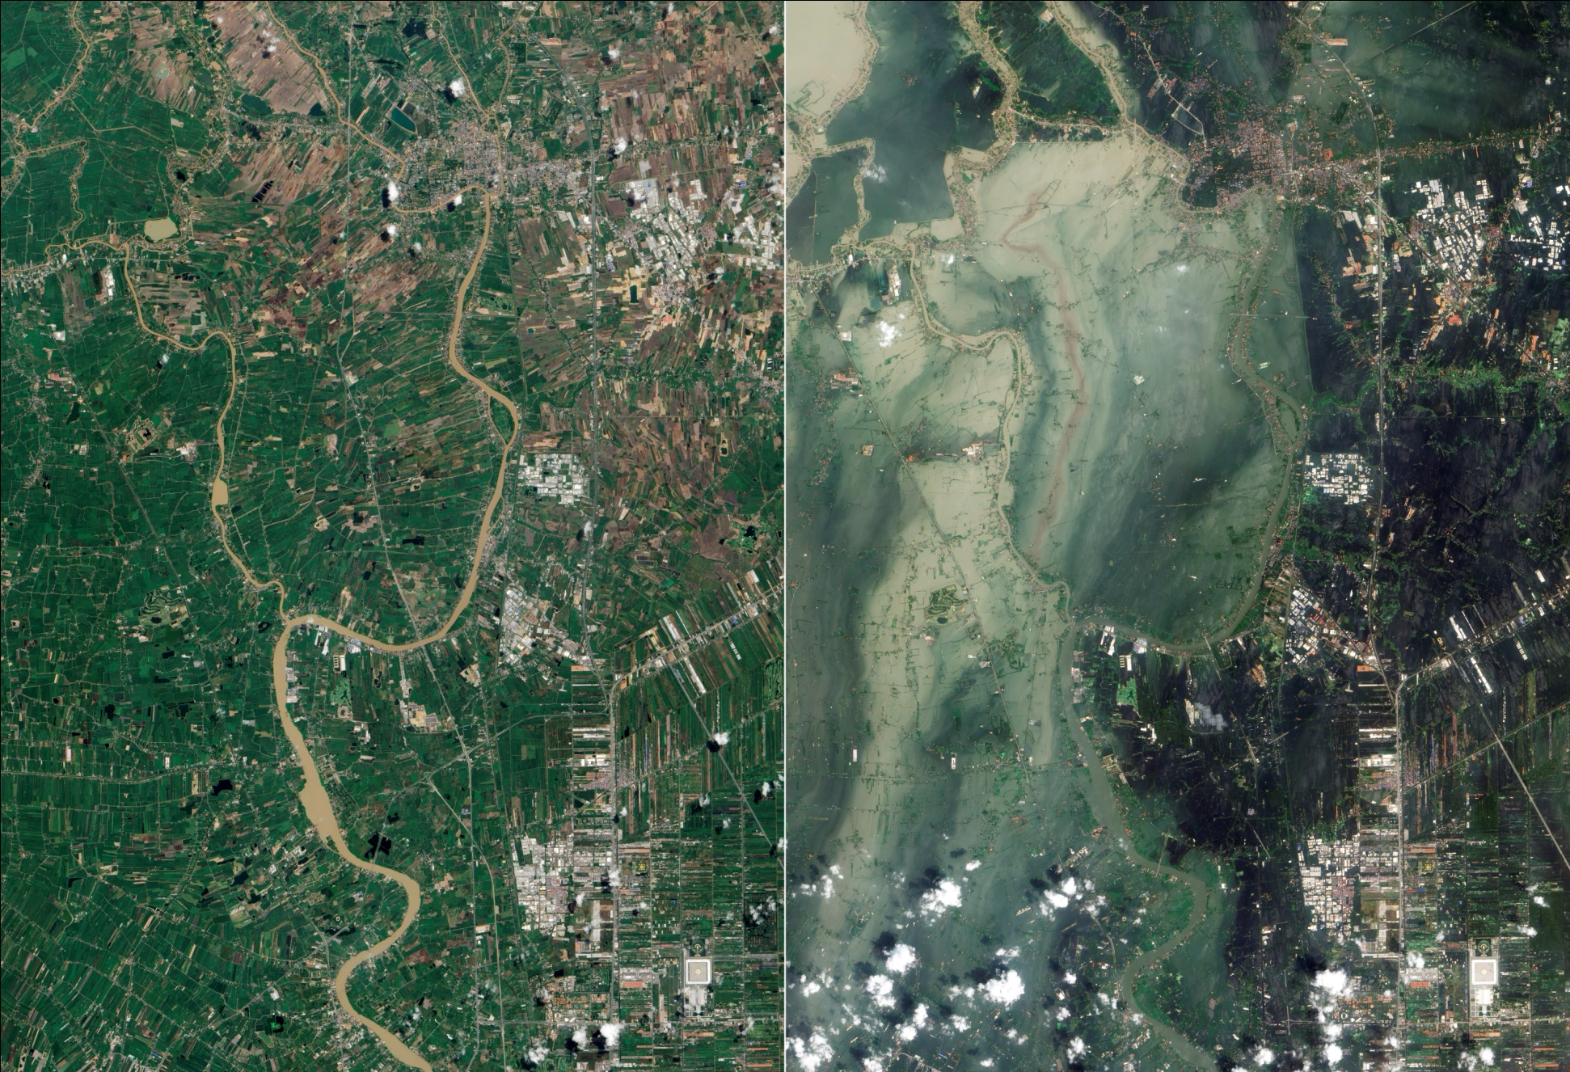
Effects of Flooding in Thailand
July, 2011
(Before)
October, 2011
(After)
Figure 9. Satellite photographs of flooded area in Ayutthaya Provinces (Located in CPRB)
Source: http://en.wikipedia.org/wiki/2011_Thailand_floods
Page 14

Slide 15
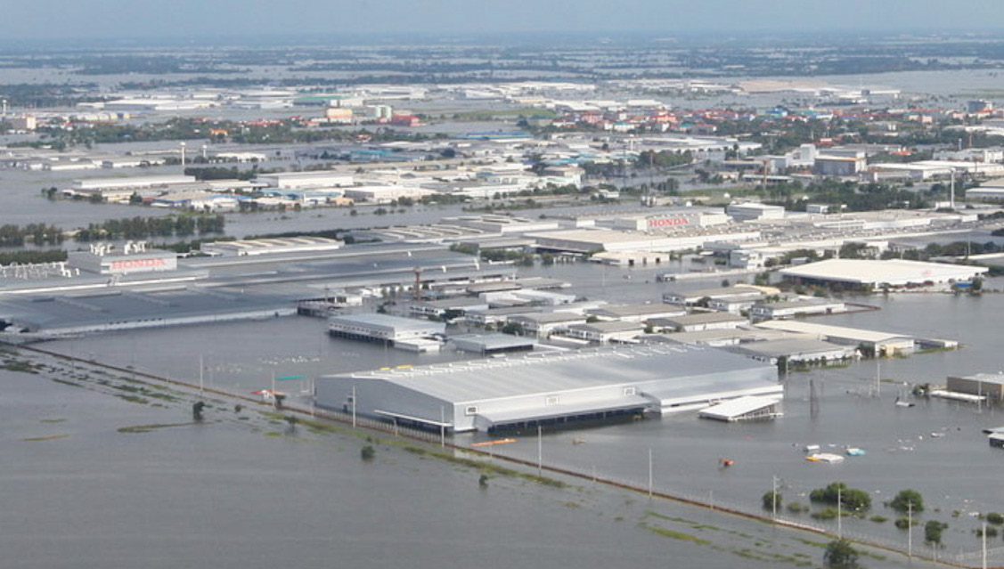
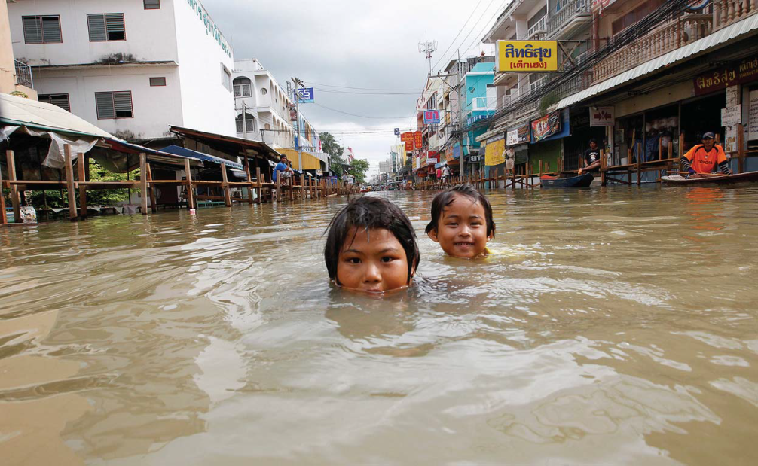
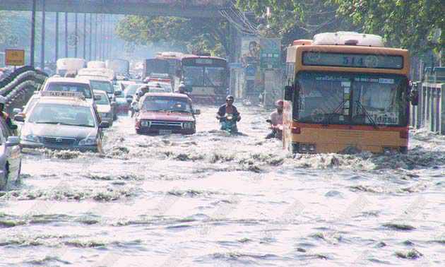
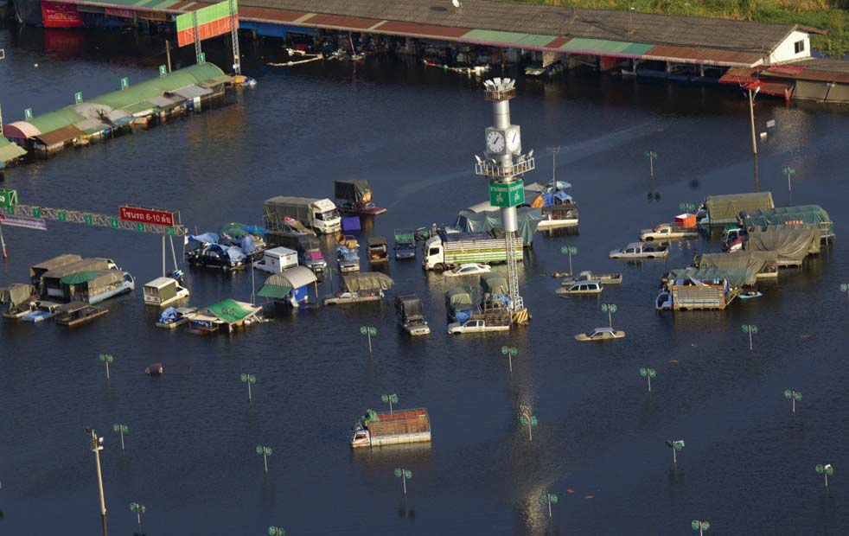
Effects of Flooding in Thailand
Figure 10. Thailand Floods (2011)
Source: Aon Corporation, 2012
Page 15

Slide 16
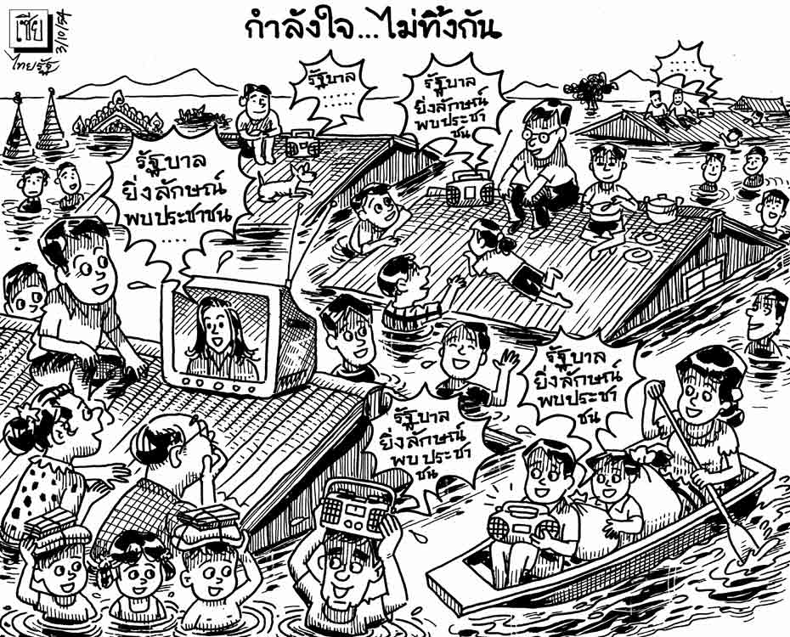
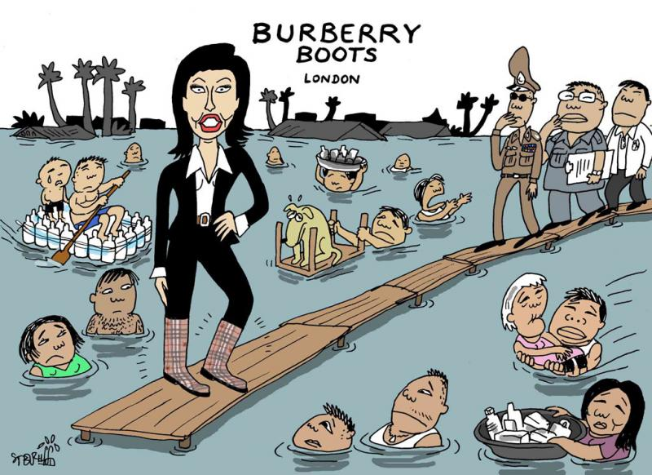
The Impact of Flood on Thai Rice
Thai government never explains what happened in 2011 and says nothing about climate change.
Thai government also reported that the impacts of flood has small or absent effected on the overall of the Thailand agriculture export (Aon Corporation, 2012).
Figure 11. Cartoon in the Nation expressing the frustration of flood-affected residents with their government
Source: http://makanaka.wordpress.com/tag/flood/
Page 16

Slide 17
The Impact of Flood on Thai Rice
The World Bank mentioned that the impact of the flood affected on the direct rice crop cultivation in the lower CPRB areas (World Bank, 2012).
The 2011 flooding in Thailand also created serious problems for the rice bowl of Asia or the lower CPRB of the country (Bank of Thailand, 2012).
Thai Rice was particularly affected, where some estimates suggested that up to 25% of the crop sustaining damage.
The projected average real growth of Thailand’s economy is 4.4% per year over the 10-year baseline, but it interrupted from the historic flood that occurred during the last quarter of 2011 (Aon Corporation, 2012).
Page 17

Slide 18
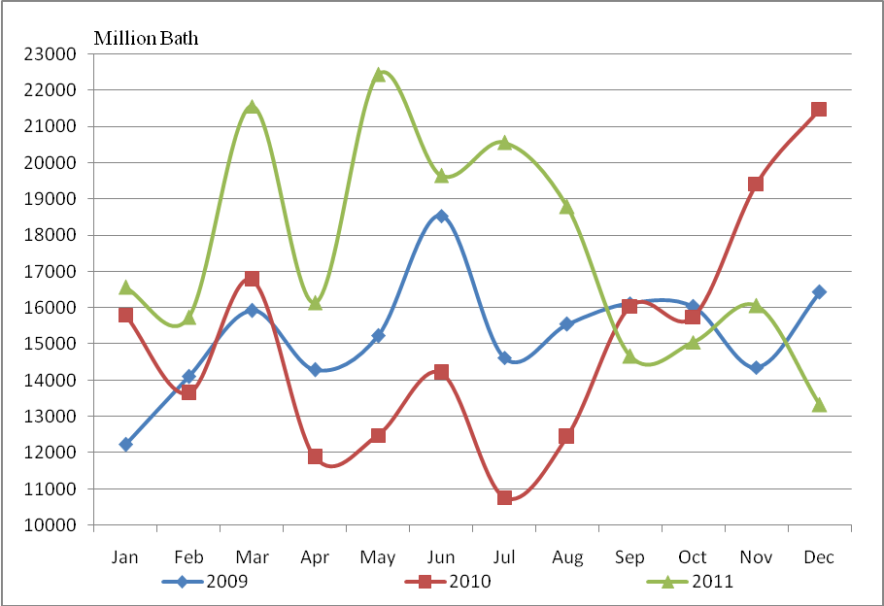
The Impact of Flood on Thai Rice
The figure showed that the export values of rice and products in the last quarter of 2011 (Green line) less than the 2010 (Red line), specific distinction in the December between of 2010 with 2011 has decreased from 21,486 to 13,328 million baht.
Figure 12. Export values of rice and products by month, 2009-2011
Source: Office of Agricultural Economics, 2012
Page 18

Slide 19
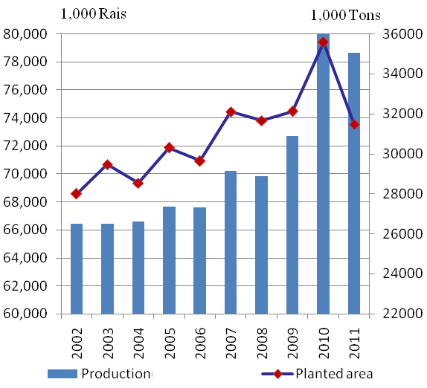
The Impact of Flood on Thai Rice
The figure illustrated that a total number of planted area and production quantity decreased from 2010 to 2011, which were occurred between the flooding phenomenon and damage of the country.
Figure 13. Major Rice and Second Rice: planted area and production, 2002-2011
Source: Office of Agricultural Economics, 2012
Page 19

Slide 20
Conclusion

Slide 21
Conclusion
Thai government and all sectors should be clear regulation of the water management and flood control projects in long-term include the following :
Control the amount of water passing the dams such as Bhumibol and Sirikit dams in the upper basin;
Construction the new dam reservoirs in the northern region;
Improvement of water resources and detention basin areas in the Nakhon- Sawan and Ayut-Thaya provinces;
Flood protection projects in the lower basin are the river diversion to the eastern part of Bangkok (as known flood way), and reform canal and drainage systems for protect urban area and agricultural cultivation.
Furthermore, they should joint clear regulation of urban and land-use planning projects in the CPRB of the central region and the flood-plain areas that used to be the area to retain water.
(World Bank, 2012; Aon Corporation, 2012)
Page 21

Slide 22





Acknowledgements
DTAIC
Asia-Pacific Chemical, Biological & Environmental Engineering Society
Adviser : Dr. Guan-Guay Mao and Dr. Tsair-Bor Yen
Page 22

Slide 23
Thank you for your attention!

